Slide 1



Online Retail Store Data Analysis
View in Power BI
Last data refresh:
09-07-2025 18:19:38 UTC
Downloaded at:
09-07-2025 18:20:45 UTC

Slide 2

BACKGROUND INFORMATION
An online retail store has hired you as a consultant to review their data and provide insights that would be valuable to the CEO and CMO of the business. The business has been performing well and the management wants to analyze what the major contributing factors are to the revenue so they can strategically plan for next year.
The leadership is interested in viewing the metrics from both an operations and marketing perspective. Management also intends to expand the business and is interested in seeking guidance into areas that are performing well so they can keep a clear focus on what’s working. They would also like to view different metrics based on the demographic information that is available in the data

Slide 3
TASKS
Question 1 The CEO of the retail store is interested to view the time series of the revenue data for the year 2011 only. He would like to view granular data by looking into revenue for each month. The CEO is interested in viewing the seasonal trends and wants to dig deeper into why these trends occur. This analysis will be helpful for the CEO to forecast for the next year.
Question 2 The CMO is interested in viewing the top 10 countries which are generating the highest revenue. Additionally, the CMO is also interested in viewing the quantity sold along with the revenue generated. The CMO does not want to have the United Kingdom in this visual.
Question 3 The CMO of the online retail store wants to view the information on the top 10 customers by revenue. He is interested in a visual that shows the greatest revenue generating customer at the start and gradually declines to the lower revenue generating customers. The CMO wants to target the higher revenue generating customers and ensure that they remain satisfied with their products.
Question 4 The CEO is looking to gain insights on the demand for their products. He wants to look at all countries and see which regions have the greatest demand for their products. Once the CEO gets an idea of the regions that have high demand, he will initiate an expansion strategy which will allow the company to target these areas and generate more business from these regions. He wants to view the entire data on a single view without the need to scroll or hover over the data points to identify the demand. There is no need to show data for the United Kingdom as the CEO is more interested in viewing the countries that have expansion opportunities

Slide 4
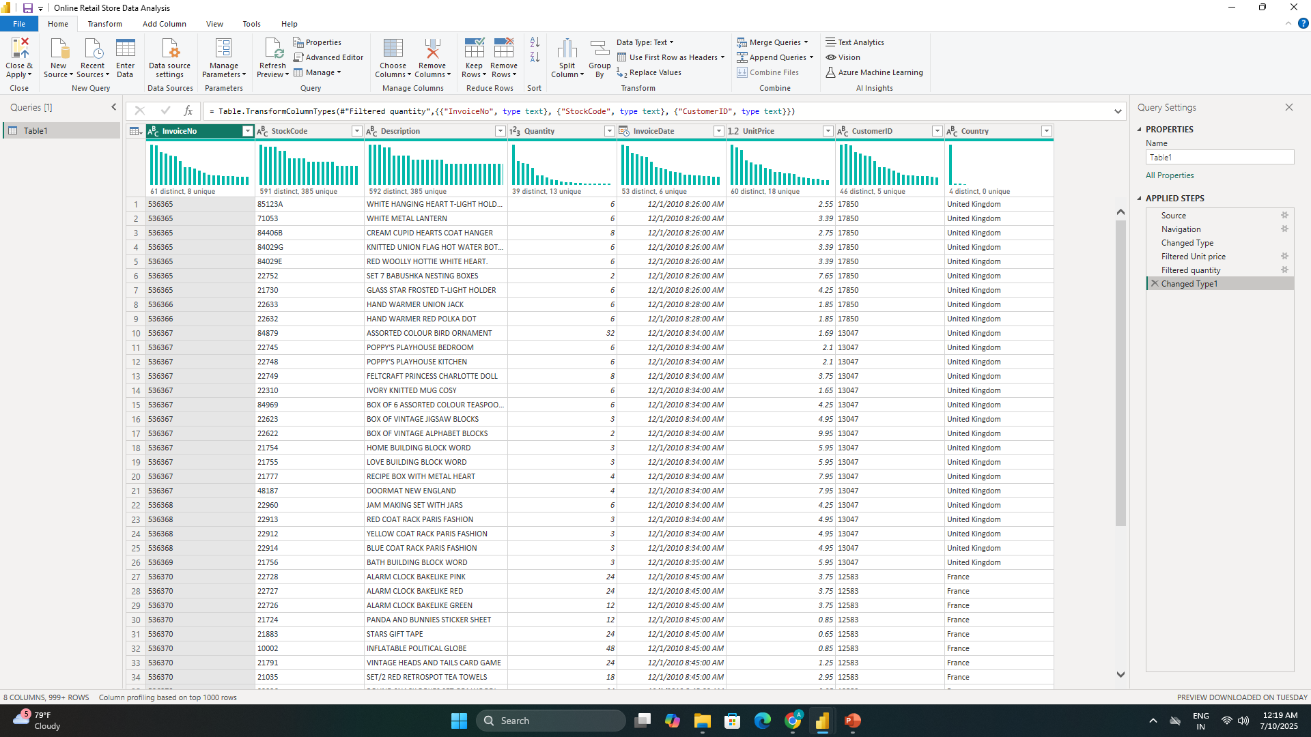

Slide 5
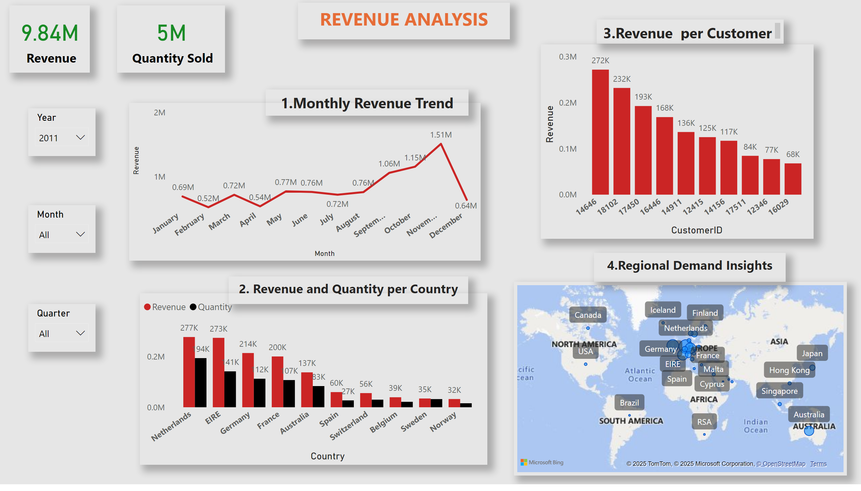
Page 1
Notes:
lineChart
No alt text provided
map
No alt text provided
slicer
No alt text provided
slicer
No alt text provided
slicer
No alt text provided
textbox
No alt text provided
textbox
No alt text provided
textbox
No alt text provided
textbox
No alt text provided
clusteredColumnChart
No alt text provided
columnChart
No alt text provided
card
No alt text provided
card
No alt text provided
textbox
No alt text provided

Slide 6
Page 1
Notes:
lineChart
No alt text provided
map
No alt text provided
slicer
No alt text provided
slicer
No alt text provided
slicer
No alt text provided
textbox
No alt text provided
textbox
No alt text provided
textbox
No alt text provided
textbox
No alt text provided
clusteredColumnChart
No alt text provided
columnChart
No alt text provided
card
No alt text provided
card
No alt text provided
textbox
No alt text provided

Slide 7
Page 1
Notes:
lineChart
No alt text provided
map
No alt text provided
slicer
No alt text provided
slicer
No alt text provided
slicer
No alt text provided
textbox
No alt text provided
textbox
No alt text provided
textbox
No alt text provided
textbox
No alt text provided
clusteredColumnChart
No alt text provided
columnChart
No alt text provided
card
No alt text provided
card
No alt text provided
textbox
No alt text provided

Slide 8
Page 1
Notes:
lineChart
No alt text provided
map
No alt text provided
slicer
No alt text provided
slicer
No alt text provided
slicer
No alt text provided
textbox
No alt text provided
textbox
No alt text provided
textbox
No alt text provided
textbox
No alt text provided
clusteredColumnChart
No alt text provided
columnChart
No alt text provided
card
No alt text provided
card
No alt text provided
textbox
No alt text provided

Slide 9
Page 1
Notes:
lineChart
No alt text provided
map
No alt text provided
slicer
No alt text provided
slicer
No alt text provided
slicer
No alt text provided
textbox
No alt text provided
textbox
No alt text provided
textbox
No alt text provided
textbox
No alt text provided
clusteredColumnChart
No alt text provided
columnChart
No alt text provided
card
No alt text provided
card
No alt text provided
textbox
No alt text provided

Slide 10
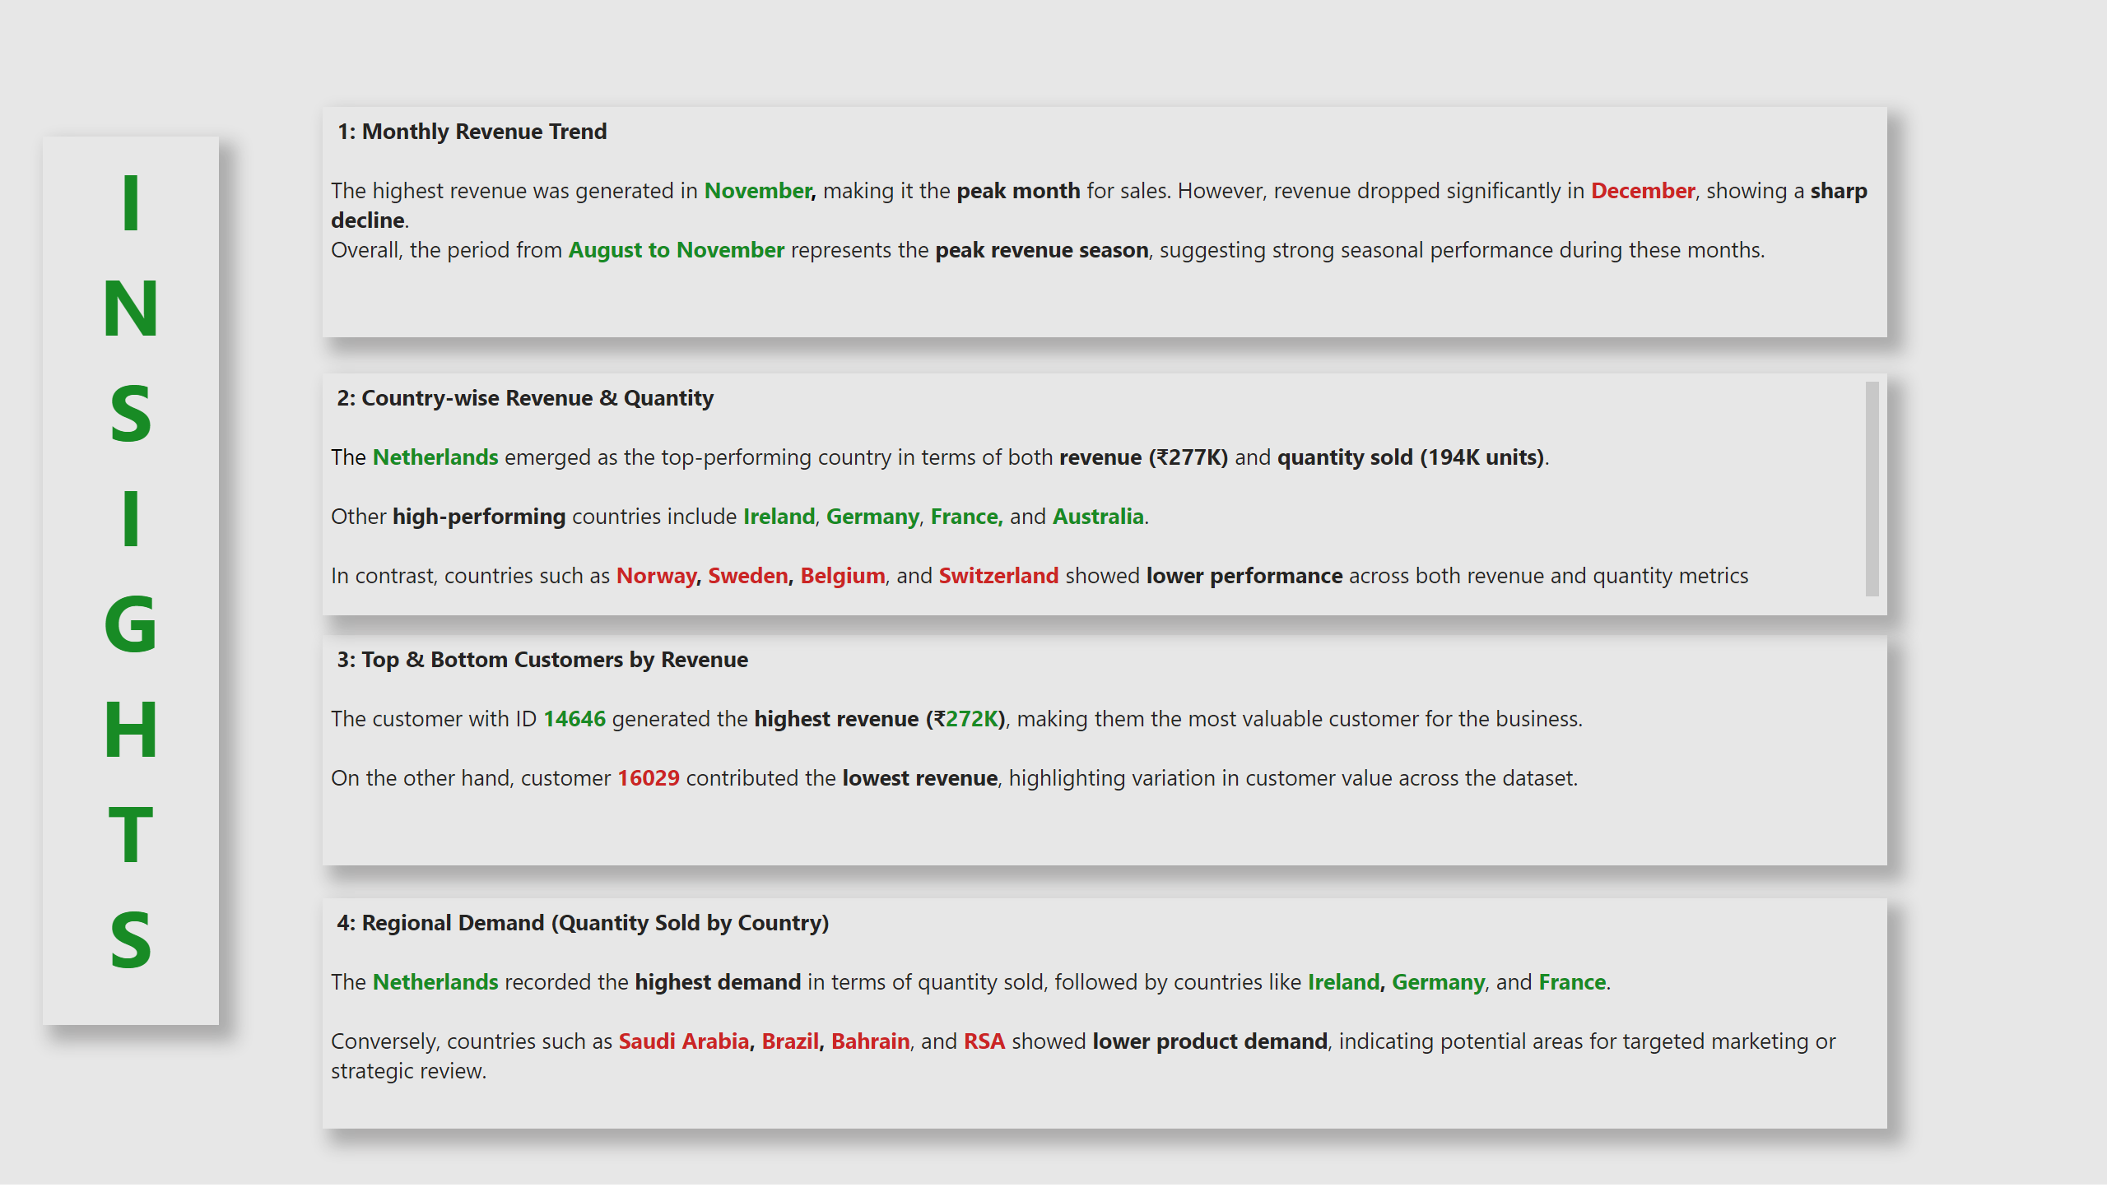
Page 2
Notes:
textbox
No alt text provided
textbox
No alt text provided
textbox
No alt text provided
textbox
No alt text provided
textbox
No alt text provided

Slide 11
Page 2
THANK YOU
Notes:
textbox
No alt text provided
textbox
No alt text provided
textbox
No alt text provided
textbox
No alt text provided
textbox
No alt text provided

